Slide 1
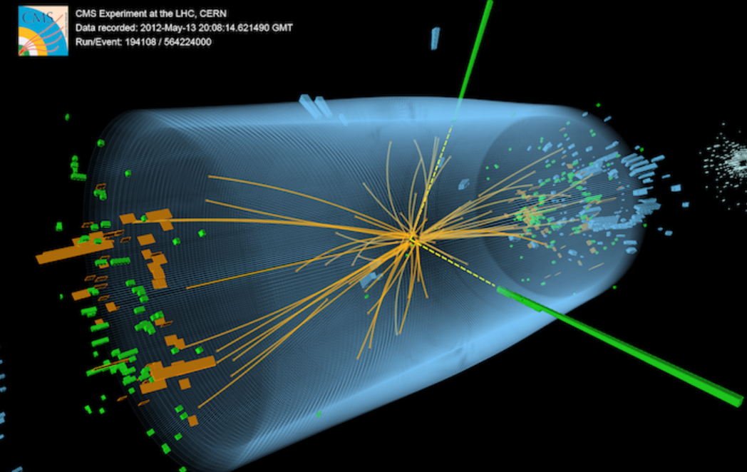
Discovering New Physics
ATLAS Trigger Project
Tim Mironov
Ophir Shurany

Slide 2
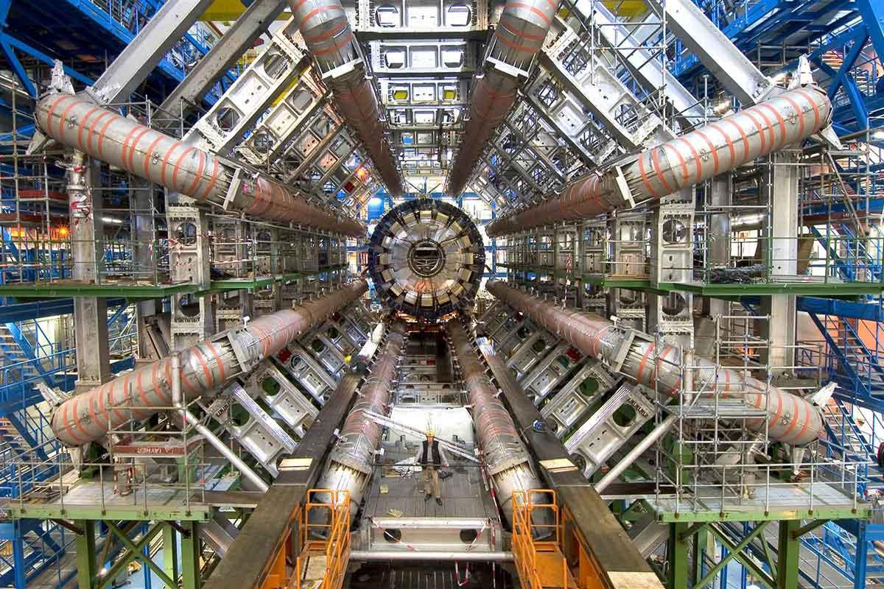
Introduction
LHC is a Large Hadron Collider at CERN, the most powerful particle accelerator on the planet. It is used to collide protons with extremely high velocities and inspect the results and physical properties of the by-products of the collision.
Notes:
In the point of collisions, the energies get as high as 13TeV
With the rate of 40 million collisions every second.

Slide 3
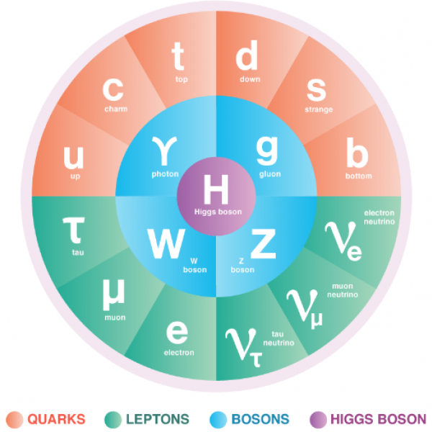
Introduction
Higg’s is a special properties particle with zero spin and large mass. This boson particle was a missing part in the “Standard Model” of physics and is responsible for the Higgs field and the mass creation of other particles.
One of the main LHC’s purposes was the detection of Higg’s Particle and measuring its different interactions and the “new physics” it creates.
Notes:
In 2012 the particle was discovered and the Nobel prize in Physics was awarded to Peter Higgs and François Englert for the theoretical predictions of the particle’s properties.
Since then the project kept upgrading and improving to be able to investigate the different interactions of particle and in particular the interactions and the physical properties of the Higg’s Boson.

Slide 4
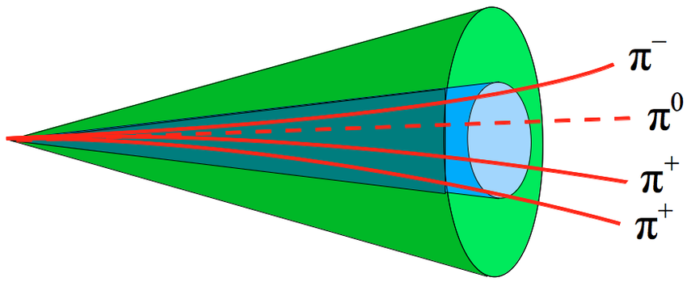
Introduction
High rate of collisions makes it impossible to record all the data produced at LHC.
ATLAS trigger system was designed specifically to solve this problem. It is a very fast online prioritizing and filtering system which in a few nanoseconds selects and flags very small portion of collision events to be stored for further analysis.
Tau-Tau trigger system is a part of the global trigger system and is responsible for detection of Higg’s decay to two Tau particles.
Notes:
Tau particle is very heavy and thus
decays fast to quarks and gluons. Its decay process leaves traces inside the detectors, which are similar to the background jets traces of particles resulting from other decays and residues from collisions.

Slide 5
Project Objective
Proposing a new method of predicting the tau-tau decay event vs. jet event using deep learning techniques on a raw calorimeter data.
Predicting correctly the event would allow us to implement on-line algorithms in the trigger level and save only events that pass a trigger and delete all others.
Next stage of ATLAS project will have higher collision rates, so efficient trigger mechanism is one of the main focuses in the current research.

Slide 6
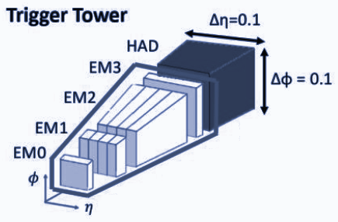
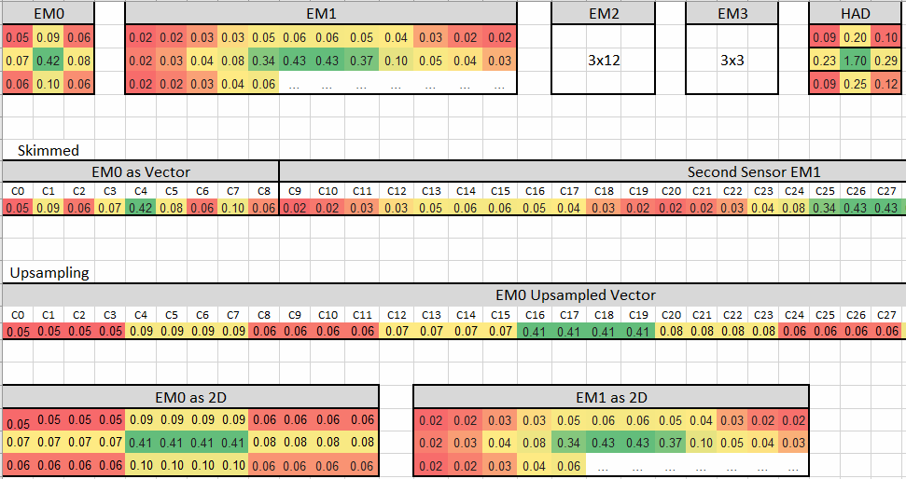
The Data
Simulation data of the tau and the jet (background) when passing the planned ATLAS detector.
The data includes raw sensors’ cell energy readings from multiple layered detectors. This data creates a structure similar to multi-spectral images with 5 channels.

Slide 7
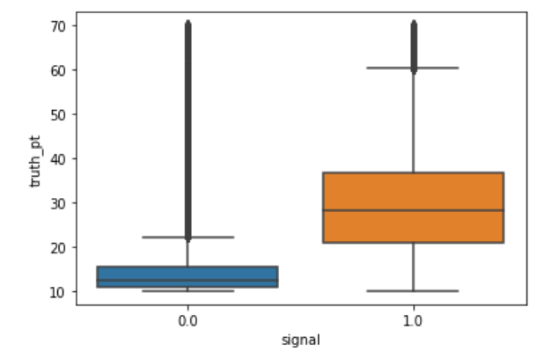
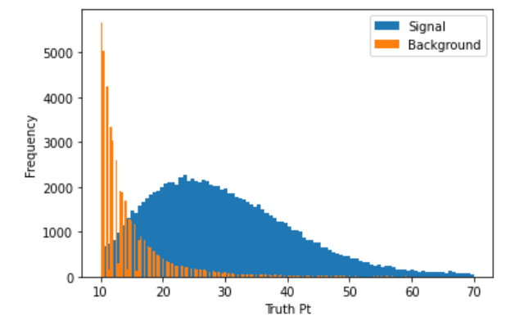
Pre-Processing
In addition to the raw sensors’ data the samples contain a total momentum measured in the event - Pt.
According to additional research and physical knowledge, we filtered the data using the following condition:
10<truth pt<70

Slide 8
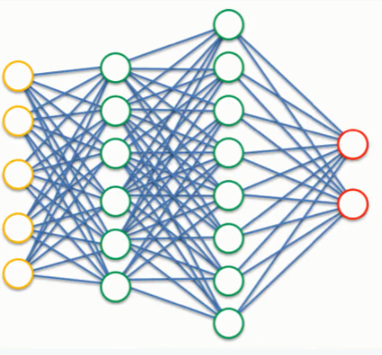
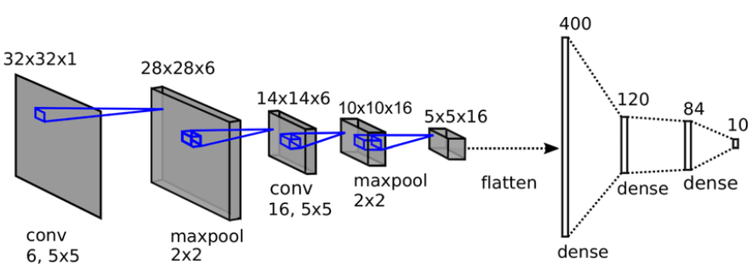
FC vs. LeNet
We have tested the dual approach to the input data: using fully connected net on the flattened vector of the energy cells deposits and using modified LeNet architecture on the partly upsampled 3x12x5 “image like” data:
Optimizing Hyperparameters:
Number of Epochs
Batch Size
Learning rate and optimizers
Dropout

Slide 9
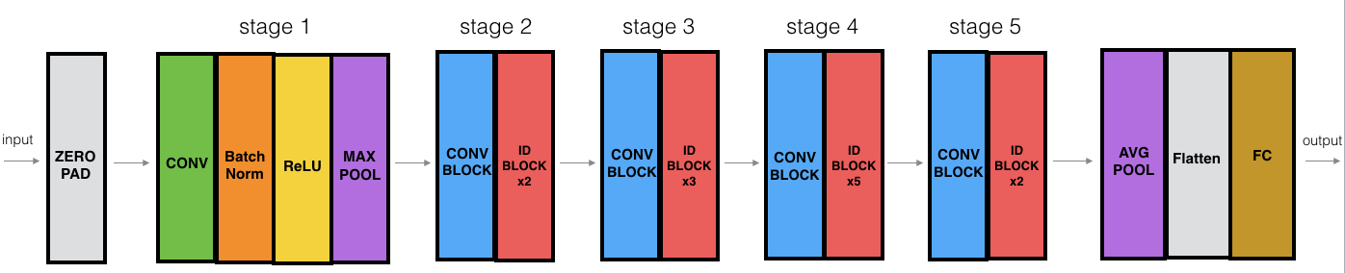
ResNet
More sophisticated approach using ResNet50 architecture by restoring flatten data back to multi-spectral images shape 3x12x5:
ID BLOCK stands for “Identity block”

Slide 10
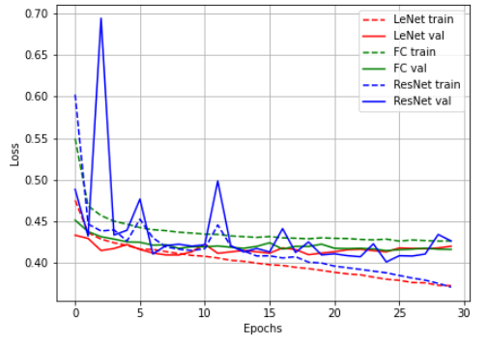
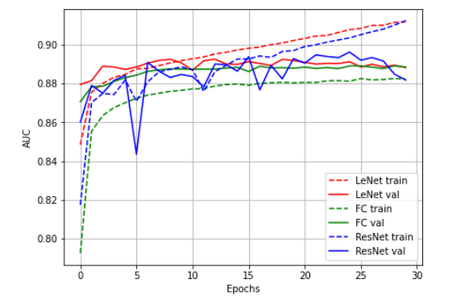
Results
Training results for the loss (categorical cross-entropy) for all three architectures.
Due to the nature of the problem we want to show the results for the AUC (area under the curve) as well:

Slide 11
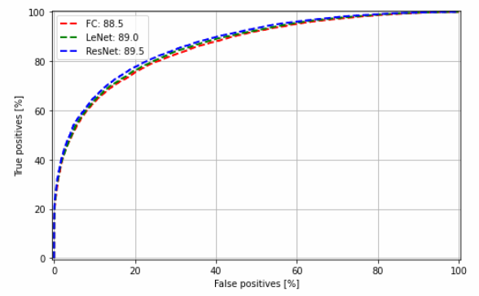
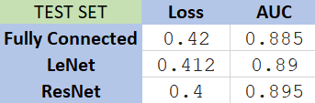
Results
Since the efficiency of the trigger system is compared to other algorithms already used in the ATLAS, ROC plot is a good way to look at the behaviour of the classifier for different False Positive rates.
We want to maximize the number of “Signal” samples saved in the experiment and to minimize the “background” irrelevant samples.

Slide 12
Conclusions
We were able to apply ML and DL techniques learned in the course on real physics problem and data; helping a TAU research team in their project.
We have implemented new architectures using TF (all previous attempts were made using PyTorch) and had a proof-of-concept on deployment of TF models to the Trigger System FPGA.
Proved that “image like” approach to the ATLAS data can yield better results with CNN techniques applied and will be even more relevant with the higher resolution of the next generation of sensors.

